Slide 1
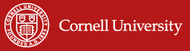
The origins and impacts of Index-Based Livestock Insurance
Prof. Christopher B. Barrett, Cornell University
Invited talk to conference on
Index-Based Livestock Insurance (IBLI):
Deepening Knowledge and Capacity
Wangari Mathai Institute, University of Nairobi
January 25, 2023

Slide 2
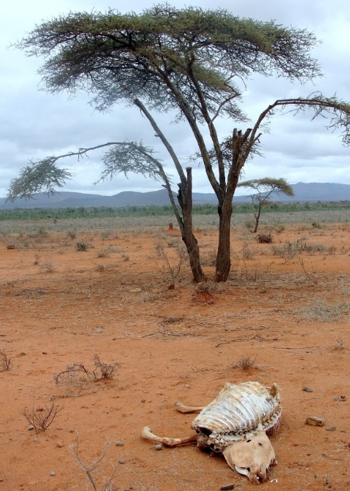
Why IBLI? Poverty Traps And Catastrophic Risk
Poverty traps exist in the arid and semi-arid lands (ASAL) of Kenya/Ethiopia. Catastrophic herd loss risk due to major droughts is the major cause of these dynamics. Puts a premium on drought risk management, both for individuals and for society.
Sources: Lybbert et al. (2004 EJ) and Santos & Barrett (2011 JDE, 2019 Barrett et al. UCP/NBER volume) on Boran in s. Ethiopia. Barrett et al. (2006 JDS), Chantarat et al. (2017 WD) for n. Kenyan pastoralists.
In the presence of stochastic poverty traps, the ‘paradox of social protection’ implies high social returns to effective risk protection. (Ikegami et al. 2019 Barrett et al. UCP/NBER volume).

Slide 3
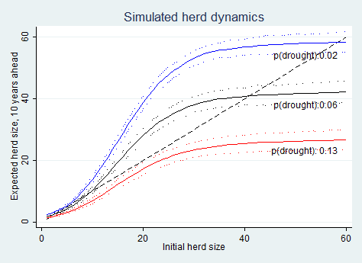
Why IBLI? Increased Risk From Climate Change
Pastoralist systems evolutionarily adapted to climate regime. But resilient to a historically rapid climate shift? If frequency of drought (<250 mm/yr) rises, recovery times shrink and system shifts.
Modeling work that mixed herders’ state conditional year-ahead herd growth expectations w/rainfall histories allow us to simulate.
In so. Ethiopia, in expectation, doubling drought risk leads to system collapse in the absence of any change to prevailing herd dynamics or drought responses.
Source: Barrett and Santos (Ecol Econ 2014)

Slide 4
Why IBLI? Standard Responses to Drought
Standard responses to major drought shocks:
1) Post-drought restocking: futile at low levels (Santos & Barrett 2019 chapter in Barrett et al. 2019 UCP/NBER volume)
2) Food aid is slow, expensive, can reinforce sedentarization, high rates of excess mortality (Nikulov et al. PLoS ONE 2016)
Moreover, if rising numbers of poor rural peoples turn increasingly to natural resource exploitation, a vicious cycle of reinforcing feedback may begin.

Slide 5
Why Index Insurance?
Insurance can:
  Prevent downward slide of vulnerable populations
  Crowd-in investment and accumulation by the poor
  Induce financial deepening by crowding-in scarce credit
  Enables focusing humanitarian resources on most needy
But conventional (indemnity) insurance unavailable b/c:
  Very high transactions costs, esp. w/little financial intermediation among pastoralists
  Moral hazard/adverse selection
  Try index insurance: low transactions costs and no moral hazard.

Slide 6
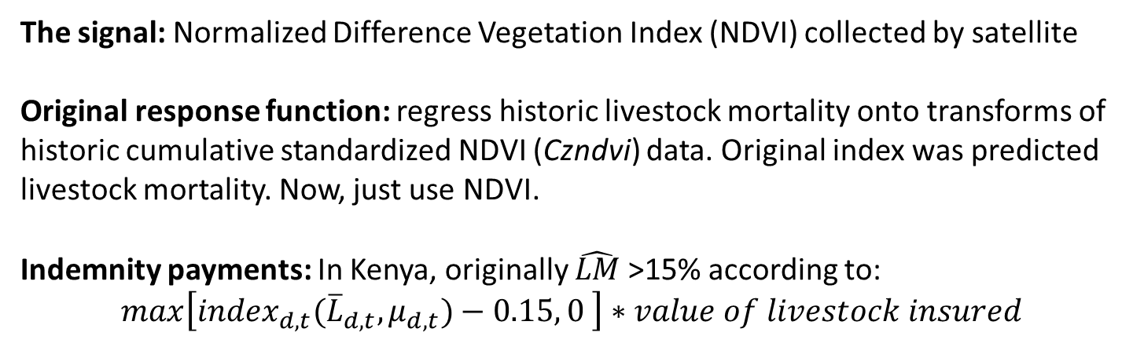
(Jensen, Barrett &2014)
How? Original IBLI Product Design
The signal: Normalized Difference Vegetation Index (NDVI) collected by satellite
Original response function: regress historic livestock mortality onto transforms of historic cumulative standardized NDVI (Czndvi) data. Original index was predicted livestock mortality. Now, just use NDVI.
Indemnity payments: In Kenya, originally $\hat{LM}$>15% according to:
$max\left[{index}_{d,t}({\overline{L}}_{d,t}, μ_{d,t})−0.15, 0 \right]∗value of livestock insured$
Temporal Structure of IBLI contract:
12-month contract sold during 2-mo sales windows just prior to usual start of seasonal rains. Payouts originally Mar 1 and/or Oct 1. Now earlier
Later updated to (i) pure NDVI play and (ii) payments early … asset protection vs. asset replacement design.
See Chantarat et al. JRI 2013; Jensen et al. Ecol Econ 2019; Fava & Vrieling COES 2021

Slide 7
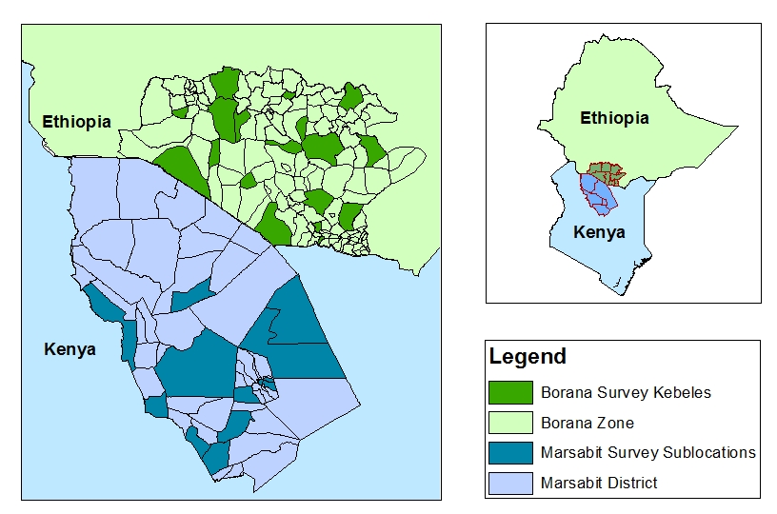
(Jensen, Barrett &2014)
How? Pilots in Ethiopia and Kenya
IBLI products (and IE surveys) launched in Marsabit, Kenya in Jan 2010 (Oct 2009) and in Borana, Ethiopia, in Aug 2012 (Mar 2012).
Kenya sampling overlaid with HSNP coverage and randomized premium discount coupon distributions as research design.

Slide 8
IBLI Uptake Significant … But So Is Disadoption
In HH surveys , in Borana (Ethiopia)/Marsabit (Kenya):
54/47% ever purchased IBLI within first 4 sales periods
But repurchase rates low: 18-68%/16-27%
High rates of disadoption : 31/41% within 2 years

Slide 9
Consistently positive IBLI impacts
IBLI coverage:
Increases vet expenditures, milk income/TLU, total hh income, child MUAC; income and milk production in drought years.
Reduced distress livestock sales, herd losses, slaughtering and meal skipping in response to indemnity payments
Increases subjective well-being by far more than buyer’s remorse effects of lapsed insurance that doesn’t pay out.
Crowds in informal transfers within communities, addressing basis risk issues and perhaps reinforcing traditional conflict resolution/social solidarity.
Marginal impact on income or MUAC is 6-45x that of HSNP cash transfers!
Jensen, Barrett & Mude JDE 2017; Toth et al. 2018; ; Janzen & Carter; Tafere, Barrett & Lentz; Takahashi, Barrett & Ikegami - all AJAE 2019; Gebrekidan et al. CRM 2019; Matsuda et al. GPRI 2019; Noritomo & Takahashi JDS 2020

Slide 10
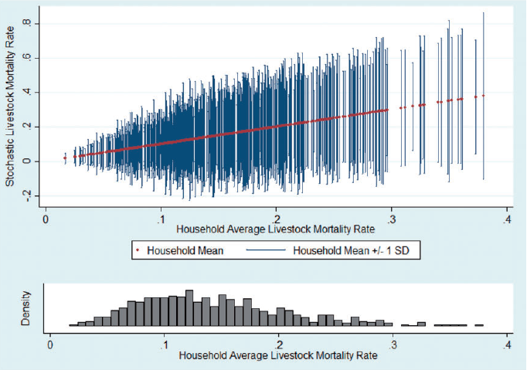
Despite imperfect/incomplete risk transfer
Covariate risk is important but household losses vary a lot …
… even for a given hh over time ...
Notes: Household-season herd loss rate spreads (mean in red, ±1 SD in blue), ordered by hh avg loss rate (top), and distribution of hh avg loss rates (bottom).
Notes: The left figure illustrates the covariate (average) loss rate in each season. The right figure illustrates the distribution of losses within each seasons. The boxes depict the interquartile range, the upper and lower adjacent values are either 3/2 the interquartile range or the value furthest from the median. The remaining observations fall outside the adjacent values.
Result: IBLI hhs still hold most risk: 62-77% of total risk exposure remains
Most basis risk is idiosyncratic and random, not targetable or correctable. So IBLI can’t stand alone intervention.
Jensen, Barrett & Mude AJAE 2016; Jensen, Mude & Barrett FP 2017

Slide 11
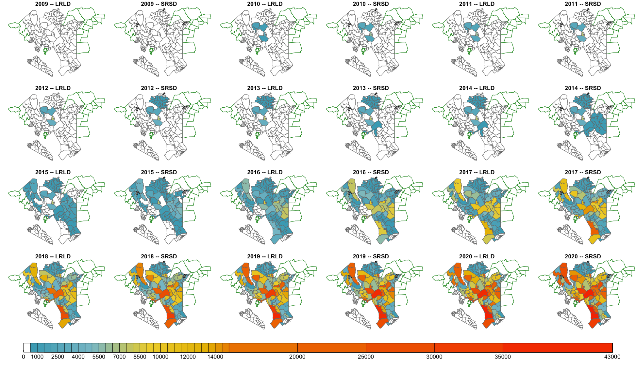
Sparked large IBLI scale-up in original domain

Slide 12
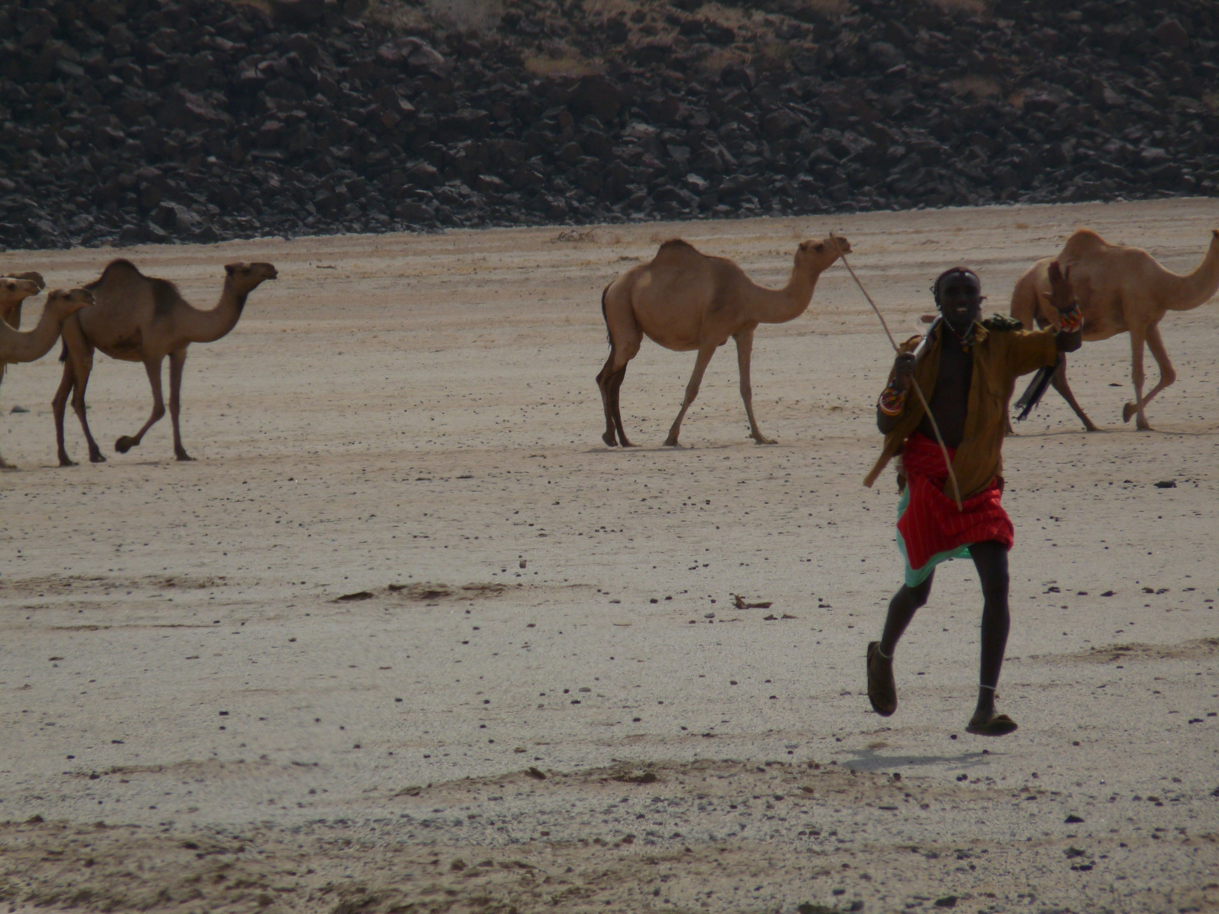
Although IBLI offers incomplete and imperfect coverage against herd loss, uptake is strong and clear, positive impacts on purchasers.
IBLI offers a promising option for addressing poverty traps that arise from catastrophic drought risk … and impacts/$ > cash transfers
Thank you for your time, interest and comments!
For more information visit https://www.drylandinnovations.com/
Notes:
12

